Slide 1

ADVERSARIAL TRAINING METHODS FOR SEMI-SUPERVISED TEXT CLASSIFICATION
Takeru Miyato, Andrew M Dai, Ian Goodfellow
Presented By :
Ashutosh Mishra
Parisha Desai

Slide 2
What is Adversarial & Virtual Adversarial Training
Adversarial Training
Augmenting the training data with small perturbations to increase the model's loss
Model learns to better handle such perturbations becoming resistant to adversarial examples., thereby improving its robustness and improves its generalization performance.
Example - standard text classifier might be trained on labeled reviews like:
"This movie was fantastic! A must-watch!" (Positive)
"The plot was terrible, and the acting was unbelievable." (Negative)
Adversarial Example: "This movie was almost fantastic! A must-watch, but the ending was a bit weak." (Subtly alters sentiment)
Virtual Adversarial Training
Extends the concept of adversarial training to semi-supervised learning scenarios (limited amount of labeled data, along with a larger pool of unlabeled data).
Model virtually modifies the text data (not actually changing the original data) in a way that maximizes the difference in the model's predicted output.
The model is then trained to minimize the difference between its predictions for the original text and the virtually perturbed text.
Example Spam Filtering with Limited Training Data
Adding common spam trigger words like "FREE!" or "Urgent!"
Virtual perturbations like slightly changing the sender's name to resemble a known spammer format (e.g., "B@nk of America" instead of "Bank of America").
Notes:
Standard text classification trains a model to categorize text data based on labels (e.g., spam/not spam).
AT introduces a new element: adversarial examples. These are modified versions of the original text data that are specifically crafted to fool the model.
The model is then trained on both the original and adversarial examples. This process strengthens the model's ability to identify the true meaning of the text and make accurate classifications, even in the presence of slight variations or manipulations.
The model would be trained to correctly classify both the original positive review and the adversarially crafted version that maintains some positivity but introduces a hint of negativity. This forces the model to learn the nuances of sentiment and not rely solely on keywords like "fantastic" or "terrible.“
VAT - Model produces similar outputs for both the original input and its adversarial counterpart.
model is trained to ensure it correctlyclassify the original email (legitimate) as "not spam" even with these virtual modifications.

Slide 3
Research Problem studied
Objective of Paper: Extend adversarial training to the text domain and evaluate its effectiveness in improving the performance of text classification models
Challenge identified by Paper : In text classification tasks due to the discrete nature of text inputs represented as high-dimensional one-hot vectors the small perturbations are not significant hence perturbation on embedding matrix is proposed
Dataset Used
IMDB | Reviews of movies (25,000 labeled dataset as positive & negative each for training and testing along with 50,000 unlabeled dataset for semi supervised learning).
Elec | Reviews of electronic products (similar size to IMDB, with extra unlabeled data for more advanced training).
RCV1 | News articles categorized by topic (more data for training and testing, with even more unlabeled data).
Rotten Tomatoes | Short movie reviews (positive or negative), split randomly into training (90%) and testing (10%), with a massive amount of unlabeled data from another source.
DBPedia | Category classification of Wikipedia pages (for supervised learning)
Notes:
These embeddings represent the meaning of words in a numerical space. By slightly adjusting these embeddings, researchers can create adversarial examples that are semantically similar to the original text but classified differently by the model.
Research Problem:
The standard approach to training text classification models involves providing labeled examples (text data with predefined categories). The model learns to classify new data based on these examples.
However, this approach might not be robust to variations in how text is phrased, especially for tasks like sentiment analysis where slight nuances can change the sentiment.
Objective of the Paper:
The paper proposes using adversarial training (AT) to improve the performance of text classification models in the text domain.

Slide 4
Approach used in Paper
The model uses a Recurrent Neural Network (RNN) with a Long Short-Term Memory (LSTM) architecture for text classification.
The RNN takes a sequence of words as input (e.g., a sentence) and predicts the corresponding class (e.g., sentiment, topic).​
The RNN consists of a word embedding layer, LSTM layer, and a softmax layer for classification.
​ A word embedding matrix is used to transform discrete word inputs into continuous vectors.

Slide 5
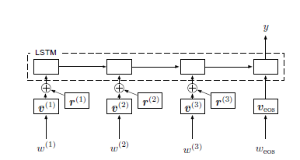
Approach used in Paper
Processes the sequence of word embeddings, capturing long-term dependencies between words.
Softmax Layer: Outputs the probability distribution for the different classes.
Word embeddings (Converts words into numerical vectors (embeddings) capturing semantic meaning)
Sequence of words
Perturbation/slight change that maximizes the loss
Notes:
Embedding- Each word is mapped to a vector containing numbers that reflect the word's meaning and its relationship to other words. This allows the model to process words more efficiently within mathematical computations.
LSTMs incorporate mechanisms that allow them to remember information for longer periods and learn from elements far apart within the sequence.
Softmax layer - This final layer takes the processed sequence from the LSTM and generates a probability distribution across various classes. In text classification, these classes might represent sentiment categories (positive, negative, neutral) or topic labels (sports, finance, entertainment). The class with the highest probability is assigned to the sequence as its classification.

Slide 6
Training Process
Pretraining
Train a recurrent language model on all the datasets (including unlabeled data) to understand word relationships to help the main model learn faster.
Word embedding matrix and LSTM weights are initialized with a pre-trained recurrent language model
Model is trained on both labeled and unlabeled examples using a unidirectional single-layer LSTM with 1024 hidden units
Trained using a sampled softmax loss with 1024 candidate samples
The Adam optimizer is used with a batch size of 256, an initial learning rate of 0.001, and a learning rate exponential decay factor of 0.9999 at each training step.
Main Model Training
The model architecture is a simple LSTM-based neural network model trained on different perturbation under different settings. Fine-tune the pre-trained model.
Adam optimizer is used with an initial learning rate of 0.0005 and a learning rate exponential decay factor of 0.9998
Batch size is defined as 64 for the IMDB, Elec, and RCV1 datasets, and 128 for the DBpedia dataset.
Model is trained for 10,000 steps on all datasets except IMDB and DBpedia, which are trained for 15,000 and 20,000 steps respectively
Hyperparameters for adversarial and virtual adversarial training, such as the norm constraint, are optimized with a validation set
Notes:
1 by 87000 dimension is getting reduced to 1 by 256 dimernsions as part of embedding matrix where 1 is
Motive : compute engine in training phase so optimum resource are used 1,00,00 steps
Main training – adversarial training happening and pertubations are being done here at embedding layer
IMDB 15,000 steps
Pretraining –
The RNN model learns to recognize patterns and relationships between words based on their statistical co-occurrence.
Focuses on understanding word embeddings, which are numerical representations of words that capture semantic meaning and relationships.
Main model training –
During training, the model refines the word embeddings and learns to associate specific patterns in the text data with the corresponding class labels (e.g., positive sentiment words or sports-related terms).

Slide 7
Results and Main Contribution
Test Error Rate | IMDB Dataset | Elec Dataset | RCV1 Dataset | Rotten Tomatoes Dataset | DBpedia
Baseline | 7.39% | 6.24% | 7.40% | 17.9% | 0.90%
Adversarial | 6.21% | 5.61% | 7.12% | 16.8% | 0.79%
Virtual Adversarial | 5.91% | 5.54% | 7.05% | 19.1% | 0.76%
Application of adversarial and virtual adversarial training to text classification tasks (extending beyond image classification).
A novel approach to apply adversarial perturbations to word embeddings instead of the original input, which is more suitable for text data
These methods improve the text classification model performance compared to the baseline method.
These training methods improve the quality of word embeddings, separating words with similar grammatical roles but different meanings ➔ enhance the semantic representation of words.
Application of these method is promising for other text domain tasks, such as machine translation, learning distributed representations of words or paragraphs, and question answering tasks.
Notes:
Baseline- using dataset containing words in discrete manner

Slide 8
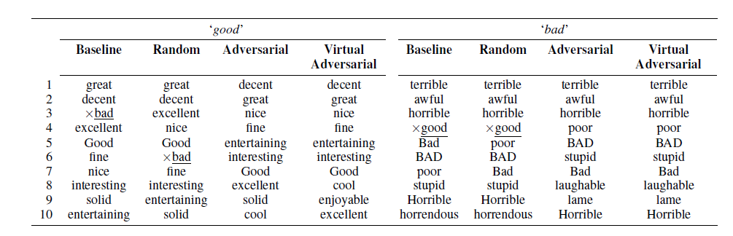
Results and Main Contribution
Notes:
Baseline- using dataset containing words in discrete manner

Slide 9
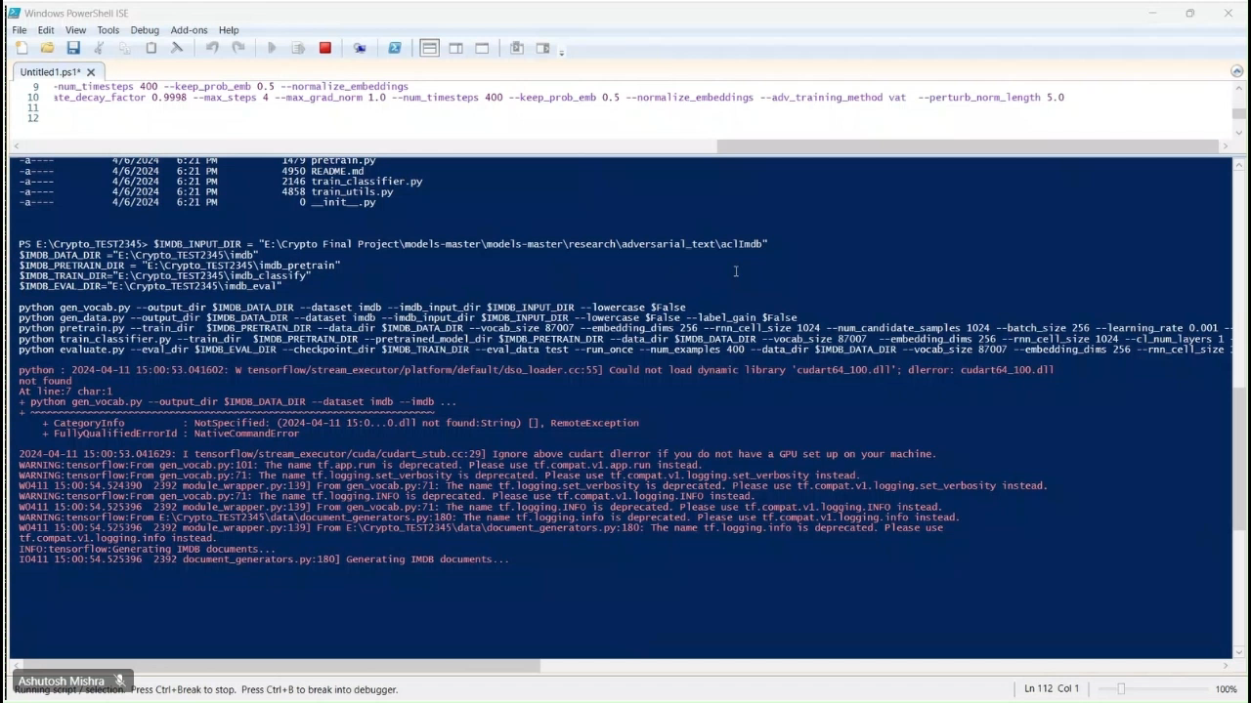
Re-implementation Demo

Slide 10
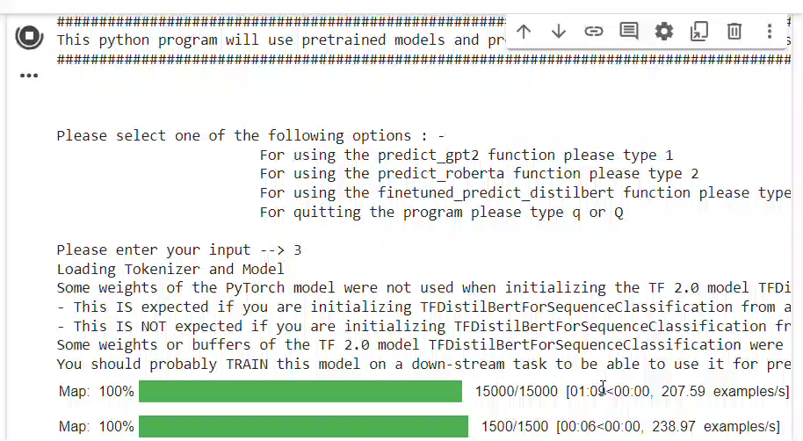
Enhancement Demo

Slide 11
Key Learnings
Adversarial training and virtual adversarial training are effective methods for regularizing supervised learning algorithms and extending them to the semi-supervised setting. ​ ​
Environment availability and setup had to be compatible with Tensorflow 1.4.0 and python version 3.6.5 for proper functioning of code
Resource availability in terms of training the model
Use of state of art transfer learning techniques using hugging face transformers models like GPT2, Distilbert, Roberta etc.

Slide 12


